Slide 1


PROJECT
HOTEL
REVIEW
ANALYSIS

Slide 2

P 322 ( GROUP 5 )
TEAM MEMBERS
MENTOR
Mr. Rachit Kumar Singh
Mr. Subham Sanjay Gagare
Mr. Sandeep Chandra Merugu
Ms. Sonali Wasudeo Gajbhiye
Mr. Tejas A G
Mrs. Vrushali Subhash Jadhav
Mr. Sanjeev Kumar Sahoo
Mr. Shaik javeer
Mr. Karthik Muskula
DATE: 07.12.2023

Slide 3
BUSINESS PROBLEM :
In this project, our goal is to examine how travelers are communicating their positive and negative experiences in online platforms for staying in a specific hotel.
BUSINESS OBJECTIVE :
This is a sample dataset which consists of 20,000reviews and ratings for different hotels and our goal is to examine how travellers are communicating their positive and negative experiences in online platforms for staying in a specific hotel and major objective is what are the attributes that travellers are considering while selecting a hotel. With this manager can understand which elements of their hotel influence more in forming a positive review or improves hotel brand image.

Slide 4
PROJECT ARCHITECTURE / PROJECT FLOW :
Business Understanding
Prediction
Deployment
Data Collection
Model Evaluation
Monitoring Data
Data Understanding
Model Building
Data Preparation (EDA)
Text Preprocessing & Sentiment Analysis

Slide 5
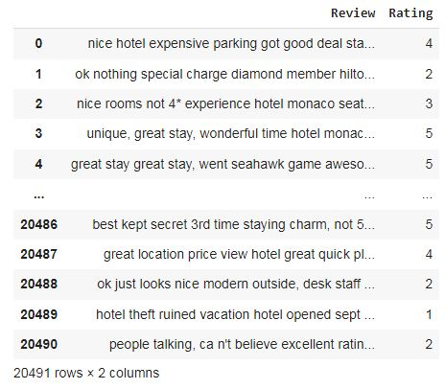
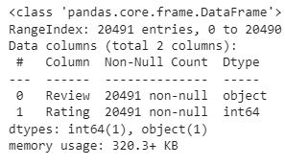
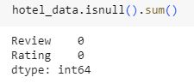
INFORMATION ABOUT DATASET :
Dataset :
Data Information :
Checking Missing values :
There is no missing values in dataset.
As for ratings, there are no blank strings.
That means there is no cleaning that needs to be done in that regard.

Slide 6
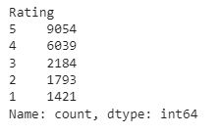
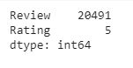
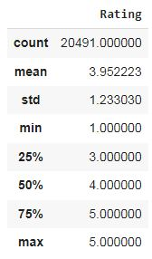
INFORMATION ABOUT DATASET :
Value count for all Ratings :
Unique Values :
Data Describe :
The dataset contains total 20491 rows and 2 columns.
The Ratings column also only has values from 1 to 5, so no weird values.
There are definitely more positive than negative reviews, so that is something to keep in mind for the model.

Slide 7
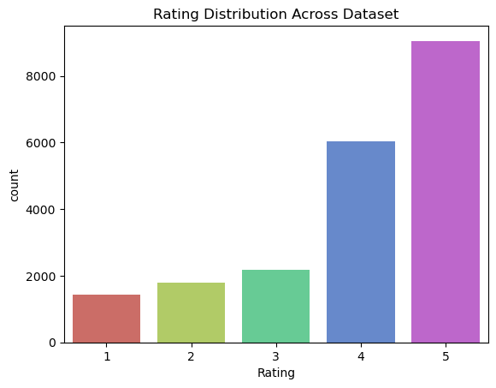
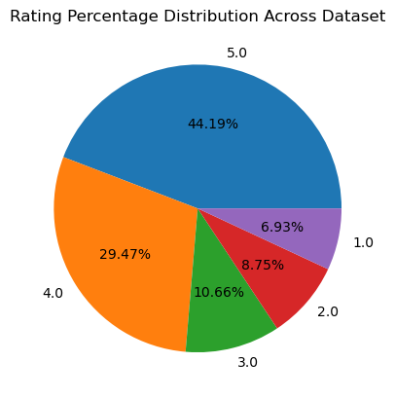
EXPLORATORY DATA ANALYSIS (EDA) :
Rating Distribution Across Dataset using Count plot & Pie chart :
From count plot we can see positive reviews are more than negative and most of people given 4 & 5 star rating.
From pie chart we can see 44.19% people given 5 star rating which is most and only 6.93% people given 1 star which is least.

Slide 8
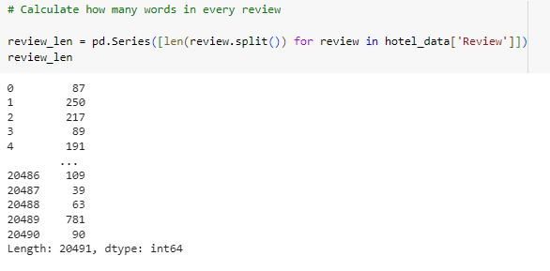
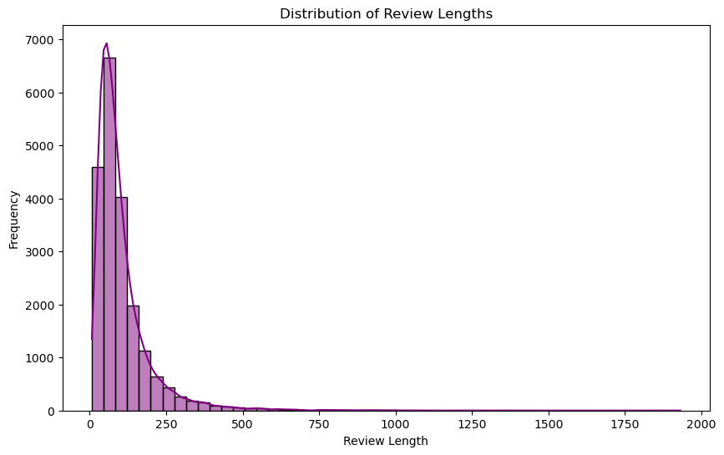
EXPLORATORY DATA ANALYSIS (EDA) :
Distribution of Review Text Lengths :
From above distribution we can see most of peoples are writing a review between 10-250 words.
The highest word written by customer is up to 2000.

Slide 9
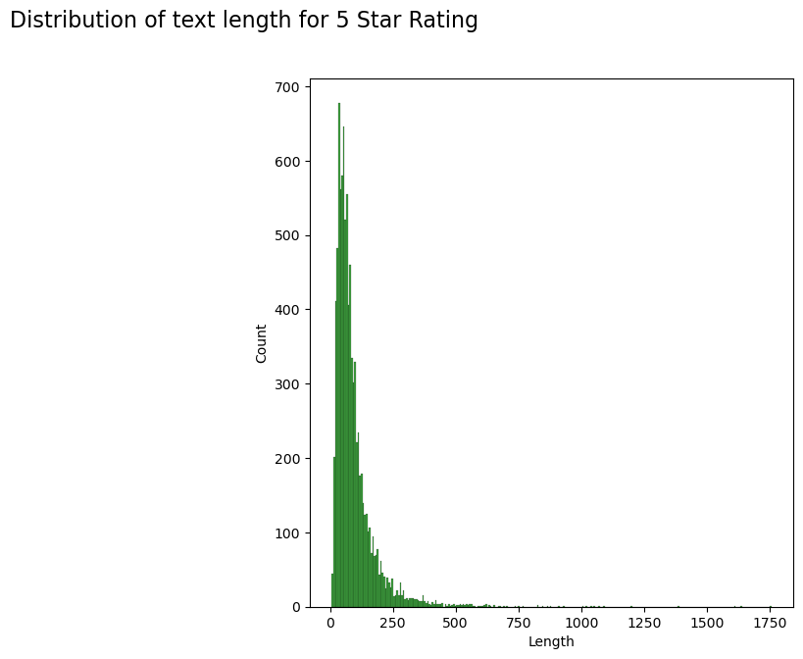
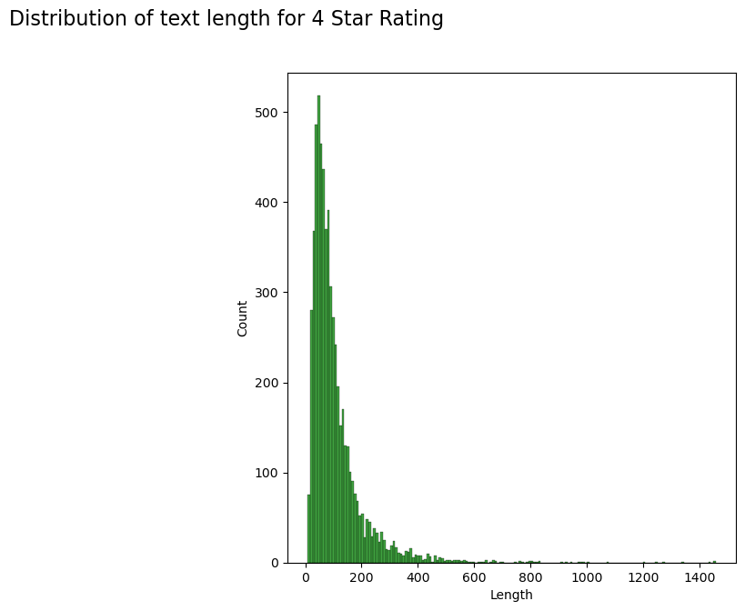
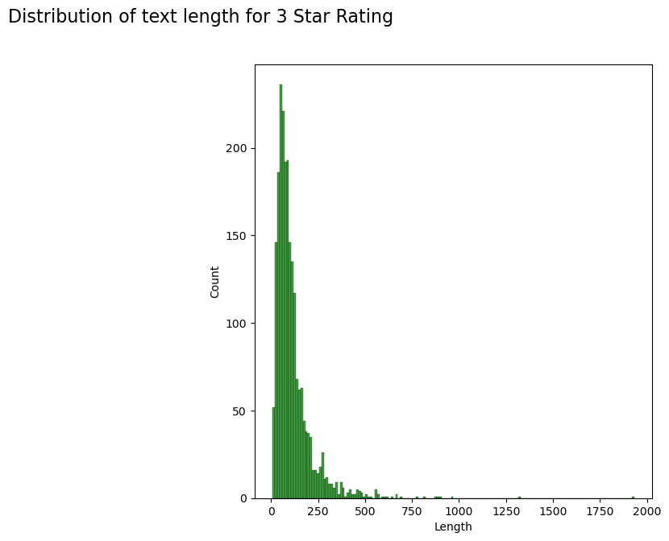
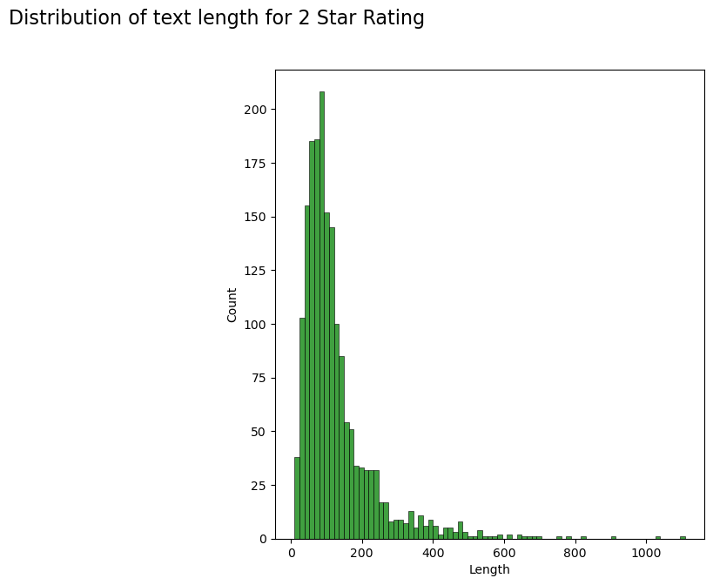
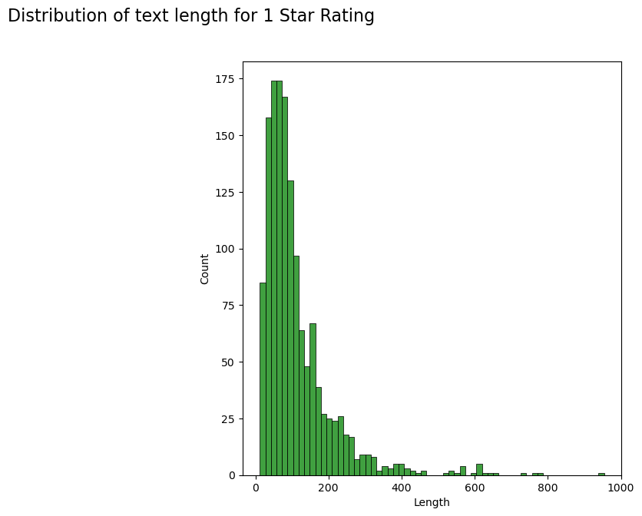
EXPLORATORY DATA ANALYSIS (EDA) :
Distribution of text length for all Ratings :
Here we can see people writing more words for highest rating.
The highest word written by customer is 1931 and it’s for 3 star rating.

Slide 10
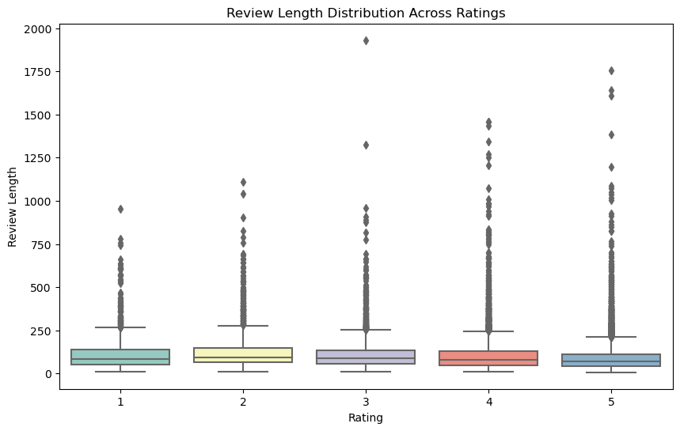
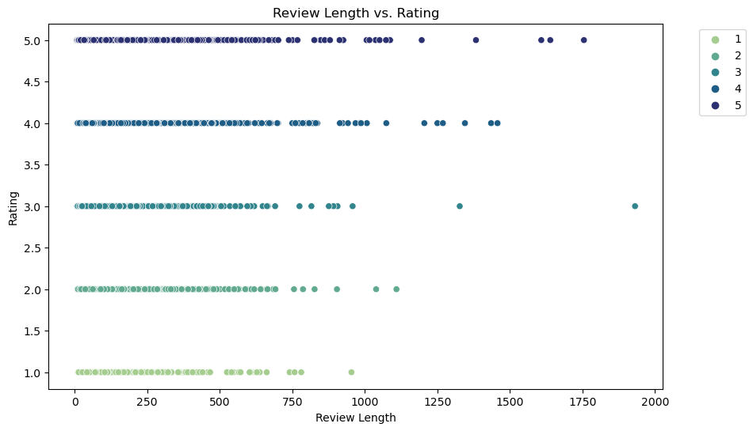
EXPLORATORY DATA ANALYSIS (EDA) :
Distribution of word lengths in review using “Box plot” & “Scattered Plot” :
Here from boxplot and scattered plot we can see there are some reviews that can be considered as outliers based on their length.
But sometimes these kind of reviews are provide more information to us, so we are keeping it.
Also we can see positive reviews are more lengthy as compared to negative reviews.

Slide 11
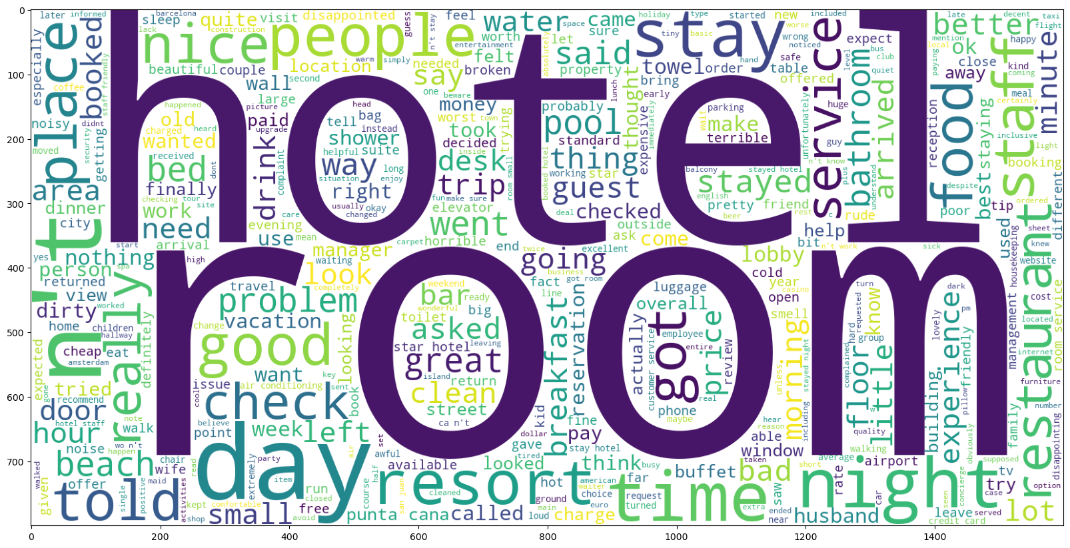
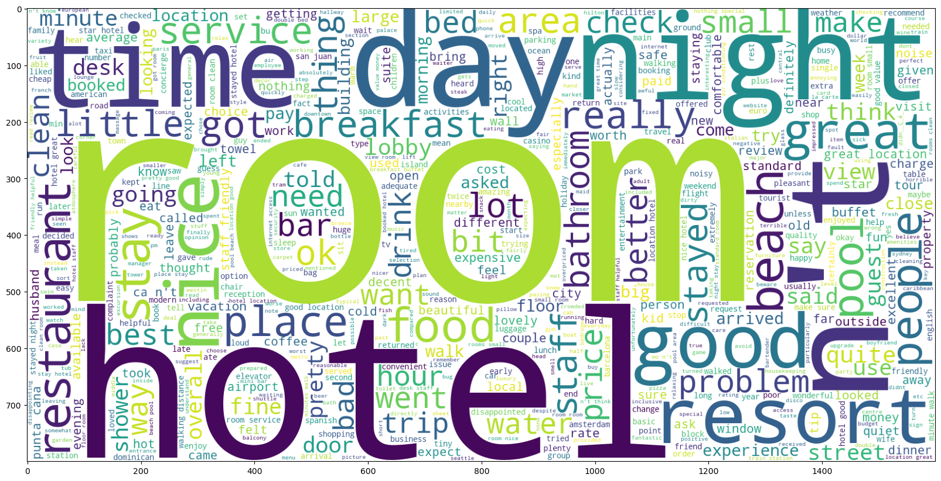
EXPLORATORY DATA ANALYSIS (EDA) :
Word Cloud for Negative Ratings :
Here we can see for Negative Ratings most of the words are indeed related to the hotels: hotel, room, staff, pool, service, food etc. Some words are more related to the customer experience with the hotel stay: nice, good, best, think etc.
Word Cloud for Neutral Ratings :
For Neutral Ratings most of the words are indeed related to the hotels: hotel, room, pool, resort, breakfast etc. Some words are more related to the customer experience with the hotel stay: good, great, clean, better etc.

Slide 12
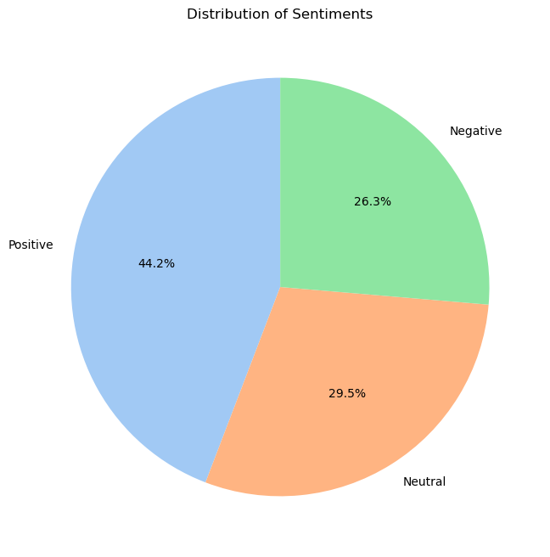
EXPLORATORY DATA ANALYSIS (EDA) :
Word Cloud for Positive Ratings :
Distribution of Sentiments using Pie Chart :
For Positive Ratings most of the words are indeed related to the hotels: hotel, room, staff, people, place, service, stay etc. Some words are more related to the customer experience with the hotel stay: nice, great, bad, free etc.
Here in pie chart positive ratings are more than others which is 44.2% and negative & neutral rating are almost equal.

Slide 13
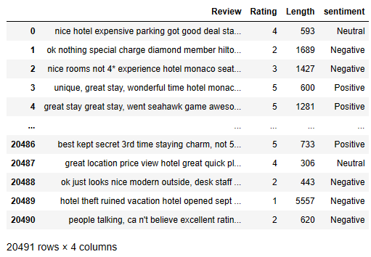
TEXT PREPROCESSING & DATA CLEANING :
Steps :
Preview of Dataset:
Make a copy of original data.
Remove all punctuations, numeric, symbols and other unnecessary white space and characters from data.
Remove the stop words.
Tokenization of each words.
Apply Lemmatization to the data.

Slide 14
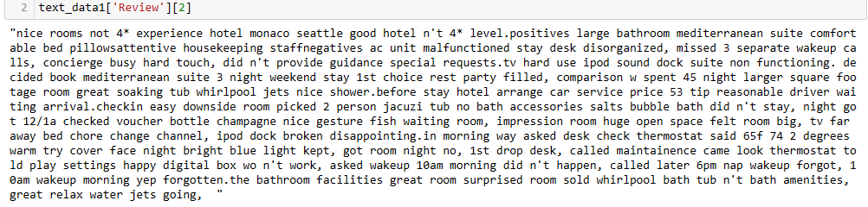
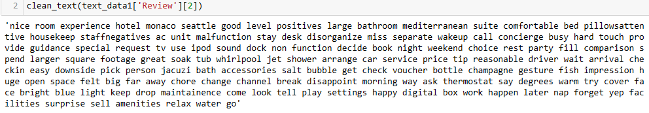
TEXT PREPROCESSING & DATA CLEANING :
Data Cleaning :
Here we have cleaned the Reviews by Removing numeric attached with words and return only alpha, Removing the strings which contains unnecessary digits, Replacing contraction words, Removing white spaces, Removing Punctuations, Removing unnecessary single characters, Removing stop words, white spaces, making words lower and joining into text and Removing duplicate words.
Then applied Tokenization and Lemmatization.
Reviews before Text Pre-processing & Cleaning :
Here before cleaning the data, text length was 1427.
Reviews after Text Pre-processing & Cleaning :
Here now after cleaning the data, text length is 934.

Slide 15
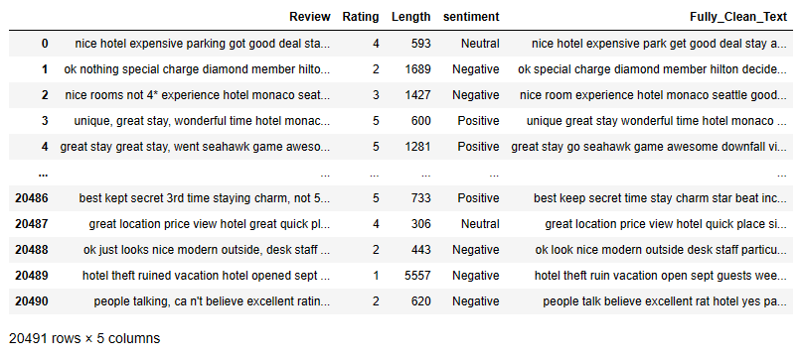
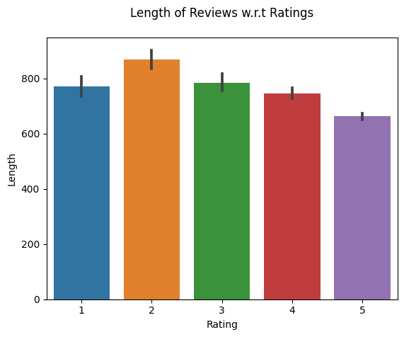
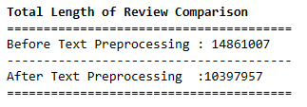
TEXT PREPROCESSING & DATA CLEANING :
Final Cleaned dataset :
Visualizing the length of reviews :
Comparing the length of reviews before & after text preprocessing :
Here is the final dataset after Cleaning and Preprocessing.
We can see the text length reduced from 14861007 to 10397957 after text preprocessing.

Slide 16
SENTIMENT ANALYSIS :
We have used following Techniques for Sentiment Analysis :
Rule Based
VADER (Valence Aware Dictionary for Sentiment Reasoning)
TextBlob
Lexicons with polarity scores – Affin
Model Based
Logistic Regression
Naive Bayes
Distilbert - Pretrained hugging face model

Slide 17
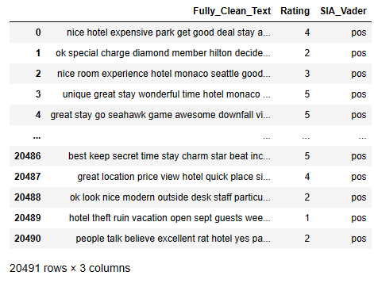
SENTIMENT ANALYSIS :
Rule Based Methods :
1. Using NLTK's VADER - Sentiment Intensity Analyzer
Vader is a lexicon and rule based sentiment analysis tool specifically calibrated to sentiments most commonly expressed on social media platforms. When calculating a polarity score Vader outputs four metrics: compound, negative, neutral and positive. The compound score calculates the sum of all lexicon ratings which is normalized between -1 (most negative) and +1 (most positive).
Dataset after applying VADER :

Slide 18
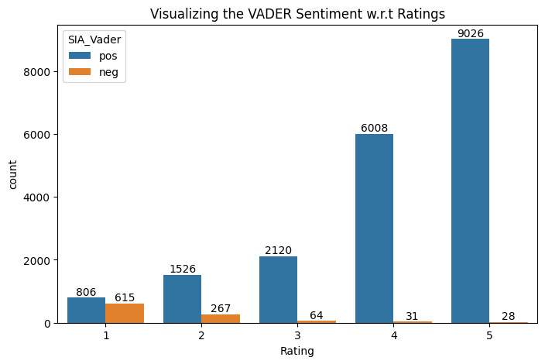
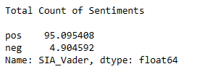
SENTIMENT ANALYSIS :
Count of VADER Sentiments :
Visualizing the Vader Sentiment :
After testing two random samples, negative sample review is incorrectly tagged as positive.
As we can see, from above sentiment analysis visual almost 95% reviews are tagged as "Positive" using NLTK's VADER approach.

Slide 19
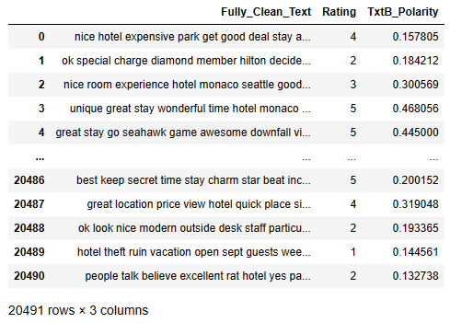
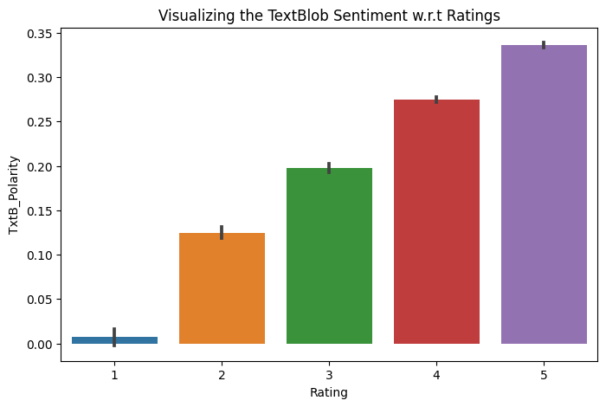
SENTIMENT ANALYSIS :
2. TextBlob:
TextBlob is built on top of NLTK and also it is very easy to use and can process the text in a few lines of code. Textblob can be used for complex analysis and working with textual data. When a sentence is passed into Textblob it gives two outputs, which are polarity and subjectivity.
Polarity is the output that lies between [-1,1], where -1 refers to negative sentiment and +1 refers to positive sentiment.
Subjectivity is the output that lies within [0,1] and refers to personal opinions and judgments.
Dataset after applying TextBlob:
Visualizing the TextBlob Sentiment :
Negative reviews polarity scores is not negative but positively low scored. Hence, it is difficult to interpret the positive & negative reviews.
After testing two random samples, negative sample review is incorrectly tagged as positive using Text Blob.

Slide 20
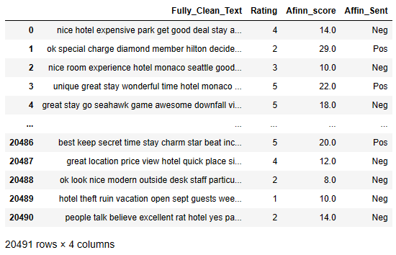
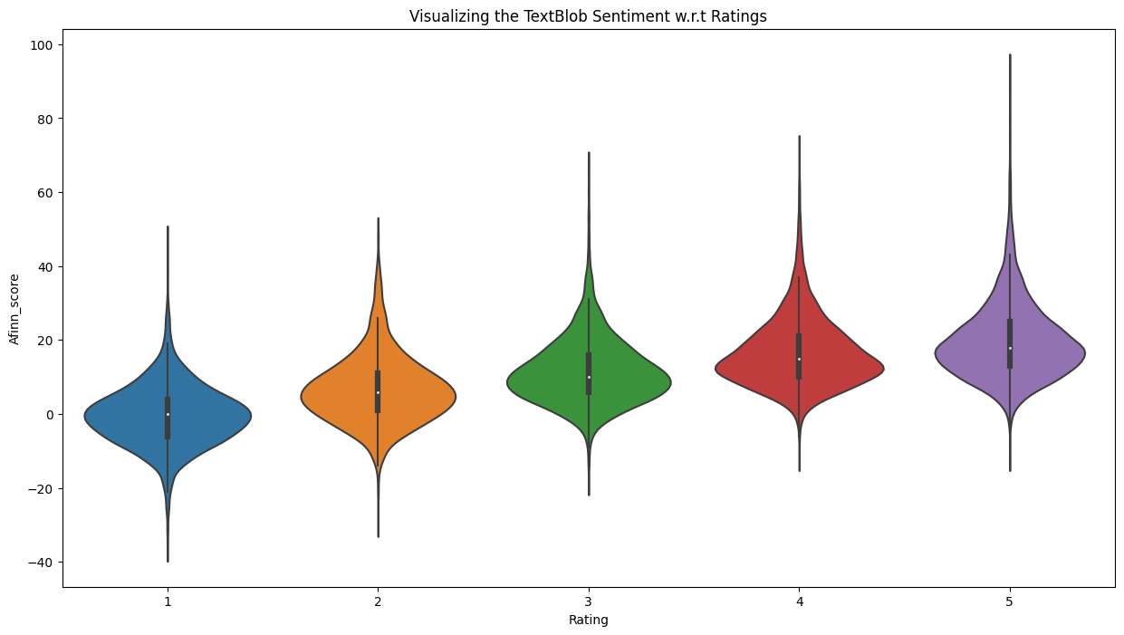
SENTIMENT ANALYSIS :
3. Afinn Sentiment Analysis:
Afinn is the simplest yet popular lexicons used for sentiment analysis developed by Finn Årup Nielsen. It contains 3300+ words with a polarity score associated with each word.
Afinn is a list of words rated for valence with an integer between minus five (negative) and plus five (positive). The comparative score is simply: sum of each token / number of tokens.
Dataset after applying Afinn :
Visualizing the Afinn Sentiment :
As we can see from above, top rated reviews min Afinn score is negative, bottom review highest afinn score is positive.
Hence, afinn is better than previously rule based sentiment analysis, but unable to segregate between lowest and highest review.

Slide 21
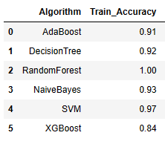
MODEL BUILDING :
Here we have used 6 Machine Learning Algorithms to build the models
AdaBoost
Decision Tree
Random Forest
Naive Bayes
SVM ( Support Vector Machine )
XgBoost
After model building we trained the model and got training accuracy score as shown in figure
As per results all the Algorithms are giving good score, but Random Forest and SVM are two with highest score.

Slide 22
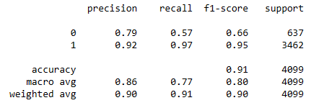
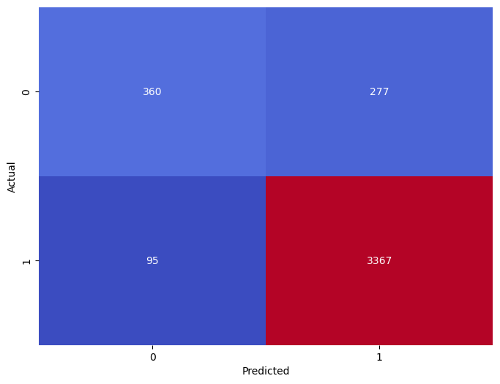
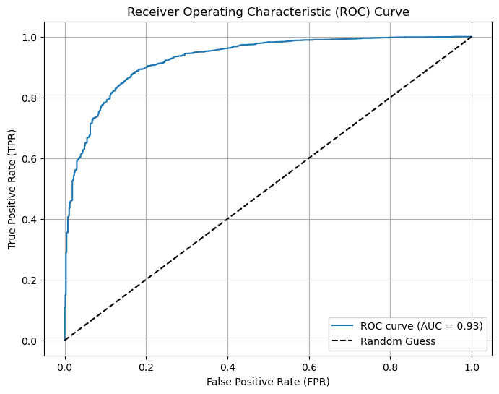
MODEL EVALUATION :
1. AdaBoost
Classification Report
Confusion Matrix
ROC Curve
From classification report we got
Accuracy Score: 0.9092
Precision Score: 0.9239
Recall Score: 0.9725
F1 Score: 0.9476
Here in confusion matrix out of those 4099 cases, the classifier predicted ‘positive’ 3644 times and ‘negative’ 455 times.
In actual it’s 3462 times ‘positive’ and 637 times ‘negative’.
Here AUC-ROC Score is 0.7688 , which is a good score.
So here overall model performance is good as per score.

Slide 23
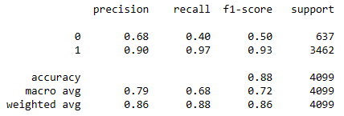
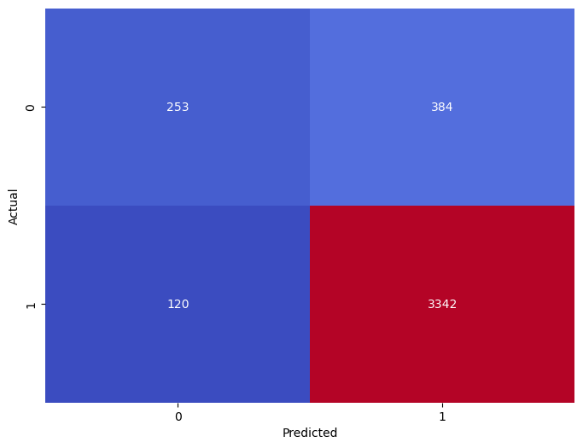
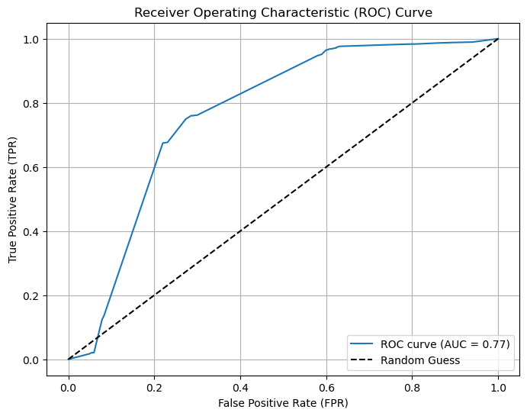
MODEL EVALUATION :
2. Decision Tree
Classification Report
Confusion Matrix
ROC Curve
From classification report we got
Accuracy Score: 0.8770
Precision Score: 0.8969
Recall Score: 0.9653
F1 Score: 0.9298
Here in confusion matrix out of those 4099 cases, the classifier predicted ‘positive’ 3726 times and ‘negative’ 373 times.
In actual it’s 3462 times ‘positive’ and 637 times ‘negative’.
Here AUC-ROC Score is 0.6812 , which is a good score.
So here overall model performance is good as per score.

Slide 24
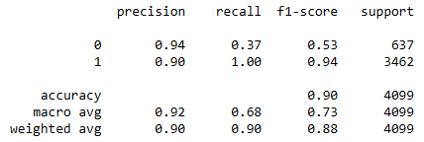
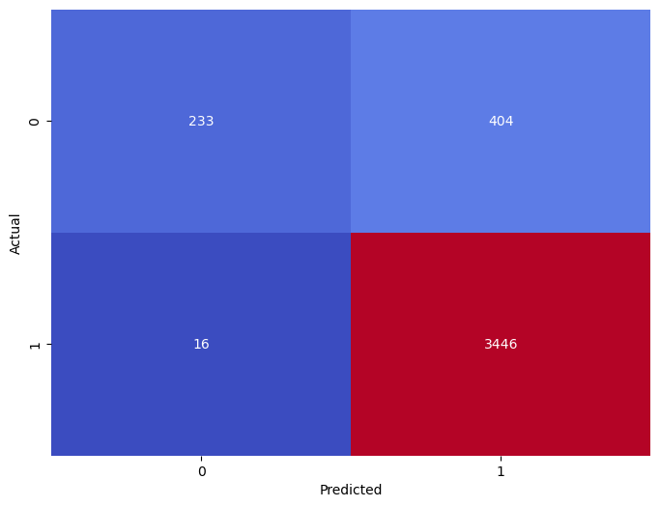
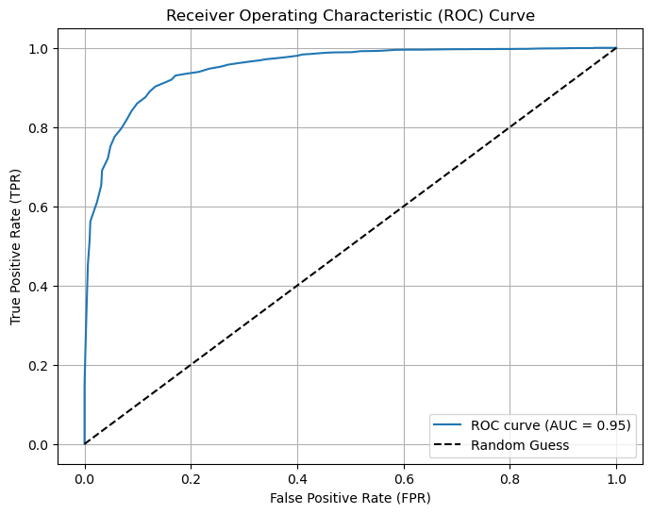
MODEL EVALUATION :
3. Random Forest
Classification Report
Confusion Matrix
ROC Curve
From classification report we got
Accuracy Score: 0.8975
Precision Score: 0.8950
Recall Score: 0.9953
F1 Score: 0.9425
Here in confusion matrix out of those 4099 cases, the classifier predicted ‘positive’ 3850 times and ‘negative’ 249 times.
In actual it’s 3462 times ‘positive’ and 637 times ‘negative’.
Here AUC-ROC Score is 0.6805 , which is a good score.
So here overall model performance is good as per score.

Slide 25
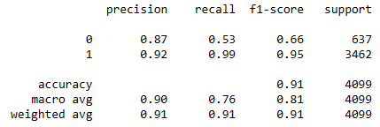
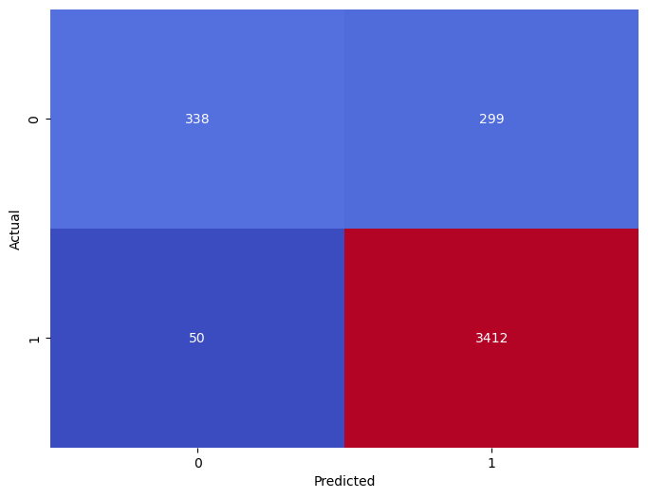
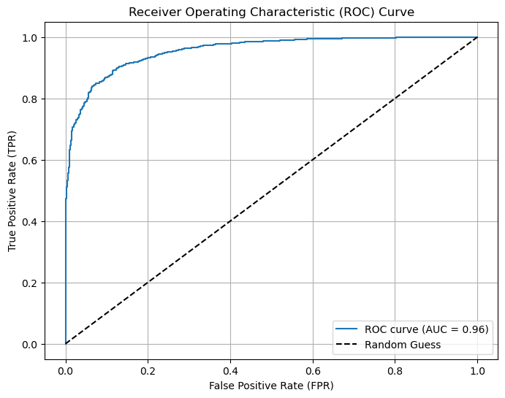
MODEL EVALUATION :
4. Naive Bayes
Classification Report
Confusion Matrix
ROC Curve
From classification report we got
Accuracy Score: 0.9148
Precision Score: 0.9194
Recall Score: 0.9855
F1 Score: 0.9513
Here in confusion matrix out of those 4099 cases, the classifier predicted ‘positive’ 3711 times and ‘negative’ 388 times.
In actual it’s 3462 times ‘positive’ and 637 times ‘negative’.
Here AUC-ROC Score is 0.7580 , which is a good score.
So here overall model performance is good as per score.

Slide 26
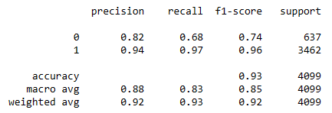
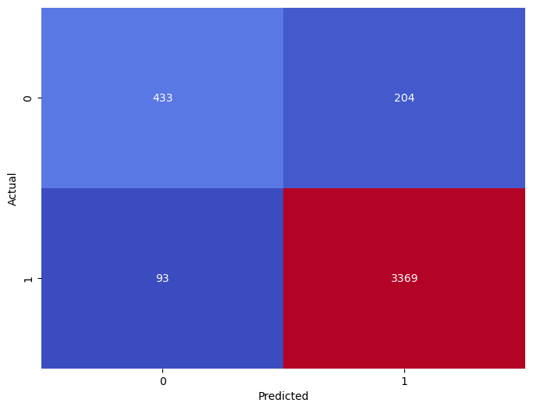
MODEL EVALUATION :
5. SVM (Support Vector Machine)
Classification Report
Confusion Matrix
Here AUC-ROC Score is 0.8264 , which is a good score.
From classification report we got
Accuracy Score: 0.9275
Precision Score: 0.9429
Recall Score: 0.9731
F1 Score: 0.9577
Here in confusion matrix out of those 4099 cases, the classifier predicted ‘positive’ 3573 times and ‘negative’ 526 times.
In actual it’s 3462 times ‘positive’ and 637 times ‘negative’.
So here overall model performance is good as per score.

Slide 27
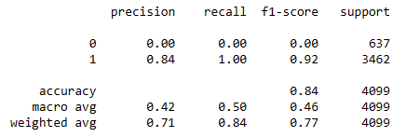
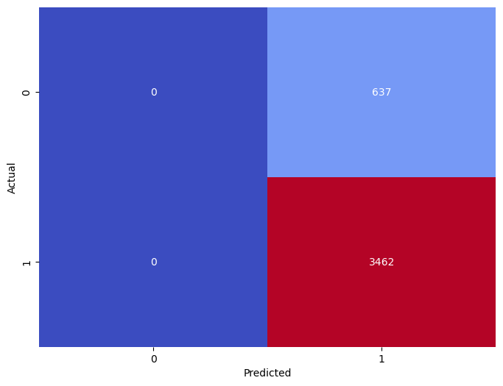

MODEL EVALUATION :
6. XgBoost
Classification Report
Confusion Matrix
ROC Curve
From classification report we got
Accuracy Score: 0.8445
Precision Score: 0.8445
Recall Score: 1.00
F1 Score: 0.9157
Here in confusion matrix the classifier predicted all are positive reviews out of those 4099 cases.
In actual it’s 3462 times ‘positive’ and 637 times ‘negative’.
Here AUC-ROC Score is 0.50.
So here overall model performance is good as per score.

Slide 28


MODEL PERFORMANCE :
So according to the results performance of all the models are good, but SVM is the best performers.

Slide 29

MODEL DEPLOYMENT :
We used Streamlit to deploy the model.
Here we used SVM model for Deployment.
As the Test Accuracy of this model is 93%, we can say our 93% predictions will be correct.

Slide 30
CONCLUSION :
Challenges Faced :
There are more positive reviews than negative in the dataset.
Also in EDA we found that most of peoples are given 4 & 5 star rating, which is almost 74%.
In sentiment analysis positive ratings are more than negative and neutral, which is 44.2%.
Choosing the best model for deployment.
Platform selection for deployment.
How did we overcome the challenges :
Here we used sentiment analysis to label the reviews as positive, neutral and negative.
Used the visualization tool Wordcloud to analyze and visualize the most frequently used words.
Used Vader, TextBlob and Affin to get polarity and subjectivity.
Also used TF-IDF to assign the weights to the keywords based on their frequency and specificity.
Finally after model building SVM model giving the best performance, So we used this model for deployment.
We used Streamlit platform for deployment as it’s easy to use and also free to hosting.

Slide 31
Thank
You !

